Slide 1
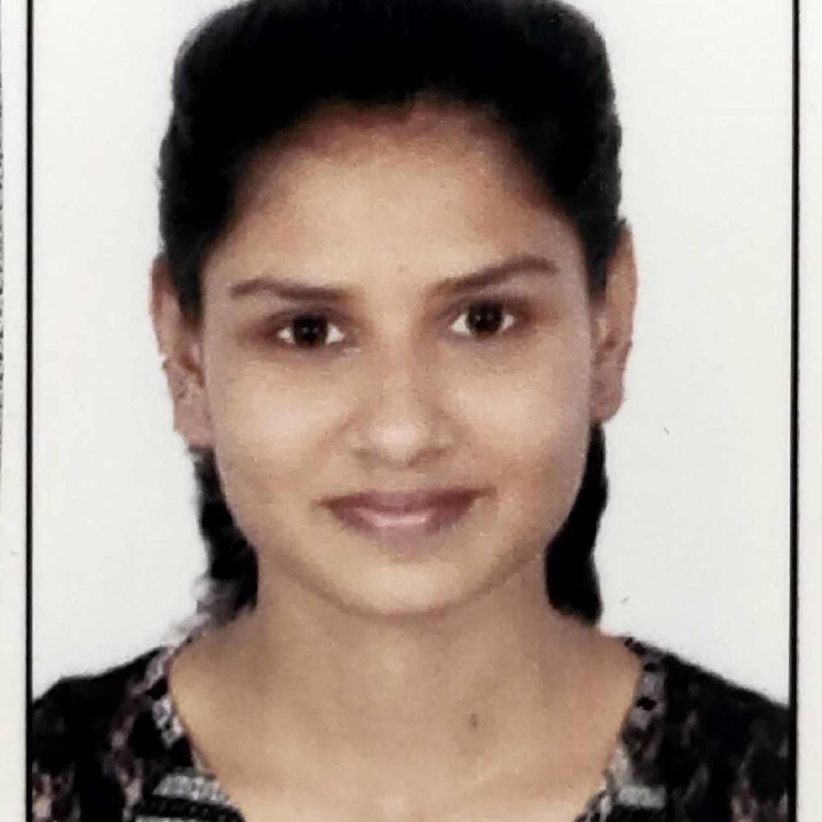



Ria Jitendra Singh
Bachelor of Engineering
Computer Science: 2021-2022
Analyst /Software Engineer
Skills
Mumbai
Java 11 /J2EE | Java Basics, OOPS, Collections, Arrays, Loops, Lambda Exp, Stream API Junit, Servlets
Spring core | IOC & Dependency Injection, Autowire
Spring REST | REST controllers, Implementation of GET, POST, PUT & DELETE, Bean Validation & Exception Handling, Testing Services, Controller & Repository layer
Spring Data JPA | Implement DAO layer using spring Data repositories, Transaction Management
Spring Boot Microservices | Spring Boot Starters, annotations, Messaging Service, Sync/Async comms, Swagger API documents
Spring Cloud | Eureka, Netflix Ribbon, Feign Client, Netflix Hystrix, Netflix Zuul & Config Server
Angular | Components, Services, Modules, Routing, Forms & Validation.
Database | MongoDB No SQL Basics, My SQL RDS Basics
UI Tech | HTML 5 & CSS 3,JavaScript, ES6 & TypeScript Reusable templates, Optimized UI Designed
Tools | Git, Postman, Maven, IDE
Add On skills | Communications, Team management. Peer learning
ria.Jitendra-singh@capgemini.com
+91 8600524402
A4
Java Full Stack Developer with Angular
Hands on experience in creating microservices with Spring boot, Spring Security, Spring Cloud Rest API Gateway, Eureka server, swagger, load balancing.
Proficient in creating Single page Web Application in Angular with Authentication with route guards, Angular reactive forms, angular routing.
Hands on experience with & spring boot in case study and upskilling the knowledge continuously.
Understanding of deploying spring boot applications.
Flight Booking System
Completed end to end case study of Flight Booking System along with JWT authentication, Swagger and payment, responsive UI with CSS and Angular used for user interface.
backend (MongoDB), Middleware (Spring Boot) and Frontend (Angular) at Capgemini Degreed Platform
Learned and recompiled all concepts of the backend, middleware and frontend technologies to polish my skills to work on real time projects.
Check out my work on GitHub & Video Profile

